Slide 1
Air Canvas Using Computer Vision and Mediapipe
Team Details
T. Abhinav (20EG105149)
T. Mounika (20EG105152)
V. Charan Teja (20EG105154)
K. Aditya (20EG105158)
Project Supervisor
Mr. D. RAMANA KUMAR
Assistant Professor

Slide 2
Abstract
Air Canvas employs advanced motion-tracking technology to capture and interpret hand movements, allowing users to create digital art through intuitive and natural gestures in the air. Conventional tools often limit the spontaneity and creativity of artists, prompting the need for a more dynamic and inclusive platform. This project is rooted in the refinement of hand tracking systems, leveraging Open Computer Vision (OpenCV) and MediaPipe technologies . The core objective revolves around transforming hand movements into an intuitive drawing tool, which allows users to easily customize tools, select colors, and manipulate virtual brushes with natural movements(waving their hand). Air Canvas is more than just a digital art tool—it's like a door to a place where your imagination can go anywhere.

Slide 3
Introduction
In today's digitally-driven era, the realm of art creation has witnessed a profound shift towards digital mediums, facilitated by advancements in technology. Digital art applications have become increasingly prevalent, offering artists and enthusiasts a diverse array of tools and platforms for creative expression.
Yet digital art creation has traditional input methods like mouse or stylus interactions, still being a limitation in terms of naturalness and expressiveness.
We aim to address this challenge by proposing a virtual painter application that leverages hand gesture recognition technology for intuitive user interactions rather than using existing methodology of conventional input methods.
Our proposed model offers an easy approach wherein users can create digital artwork through their hand movements and gestures. By utilizing the HandTracker class from the MediaPipe library, the application tracks hand movements and recognizes gestures in real-time video frames, providing users with a seamless and immersive drawing experience.

Slide 4
Problem Statement
To develop an innovative computer vision-based drawing application which addresses the limitations of conventional input devices by enabling users to draw in the air through hand gestures while also serving as a communication tool for individuals with hearing impairments.

Slide 5
Problem Illustration
Paper wastage- Using paper for writing unnecessary things, drawing small things and throwing entire paper led to conditions of wastage of paper. The fact is many trees need to cut down for making single notebook.
Requirement of hardware device like Pens, Graphic Tablets, Mouse and Trackpad. Avoiding Hardware reduces the cost of the application which in turn results in greater accessibility for people.
Writing or drawing using air canvas can solve this problem. Also new technology can draw children's attention to education as it can be used for education. Air canvas uses no paper it requires only some part of memory. A papers wastage can be not increasing anymore. Safe distance needed while make use of air canvas so it will not affect your eyes also.

Slide 6
Proposed Method
In the proposed methodology, the interactive air canvas application seamlessly integrates computer vision and gesture recognition techniques to enable a dynamic and engaging user experience. The process begins by capturing video frames from the webcam. Each frame undergoes preprocessing steps, such as flipping it vertically and converting it to the RGB color space using OpenCV . The MediaPipe library is then employed to detect hand landmarks within the frame. Subsequently, the code interprets the detected hand gestures, recognizing actions like color selection, canvas clearing, and drawing. The loop dynamically updates the canvas based on the hand movements, continuously displaying the evolving output to the user.

Slide 7
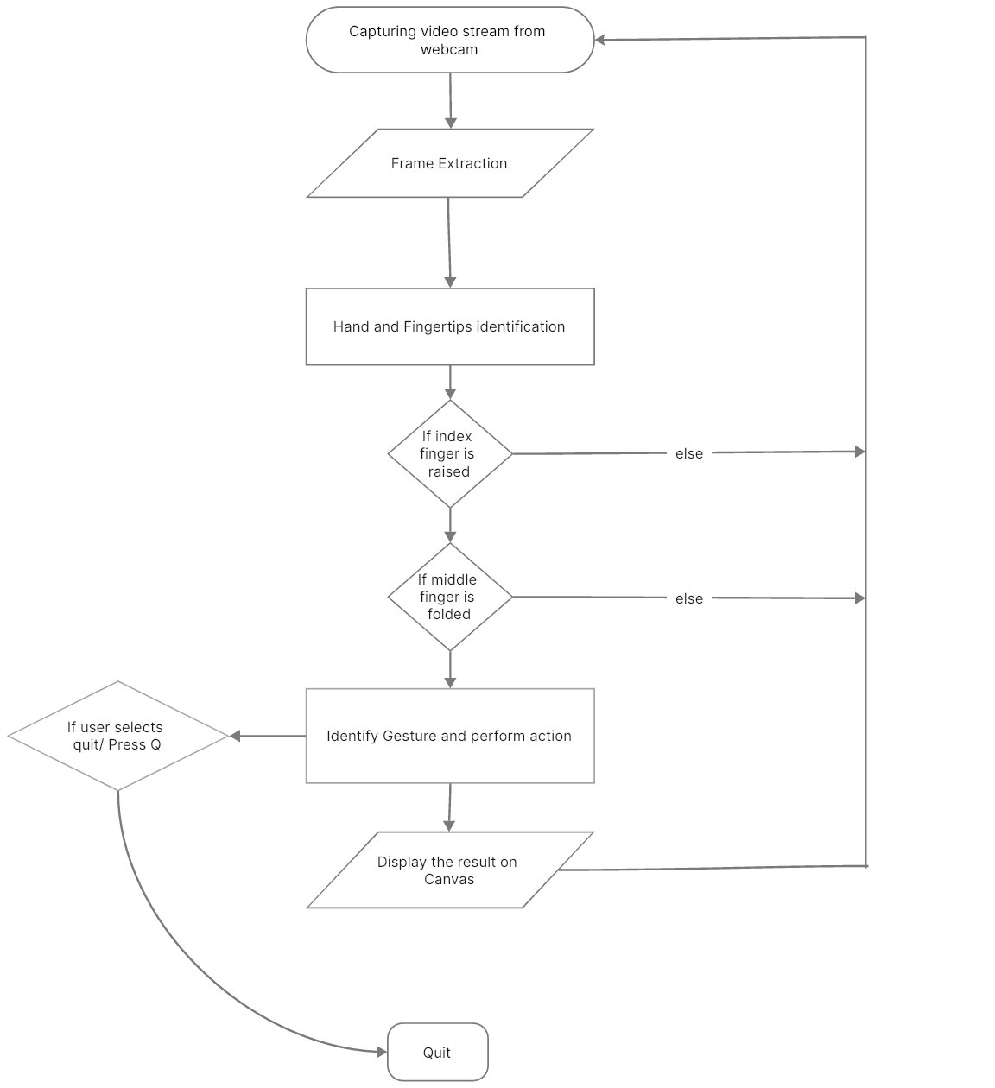
Proposed Method Illustration

Slide 8
Experiment Environment
Software requirements
Visual Studio
Media Pipe
Numpy
OpenCv
Hardware requirements
Webcam
Monitor (Display/Screen)

Slide 9
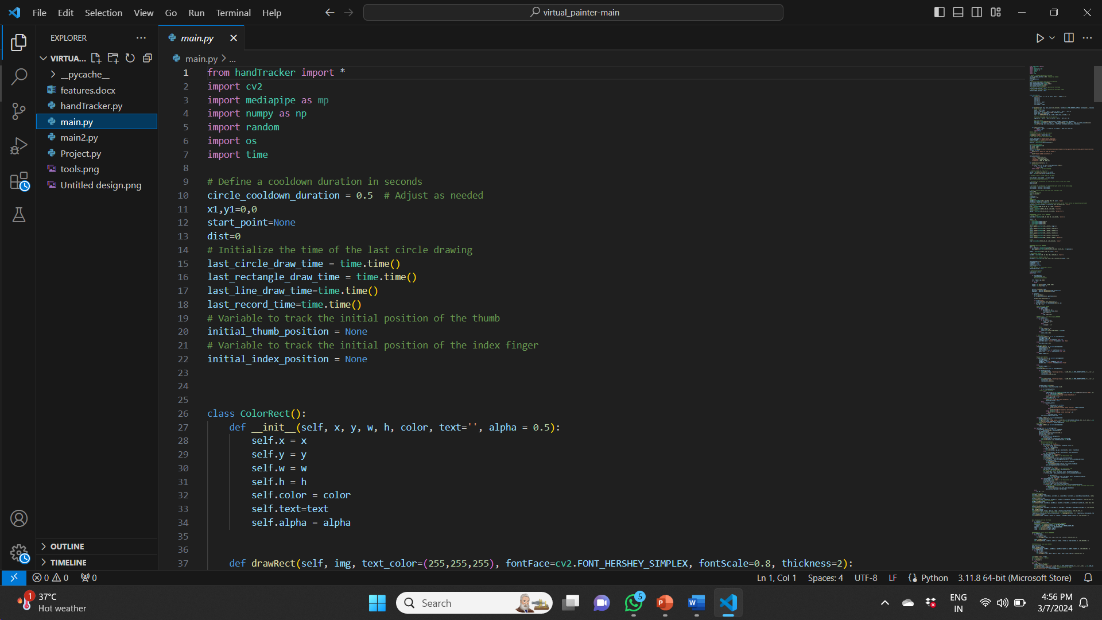
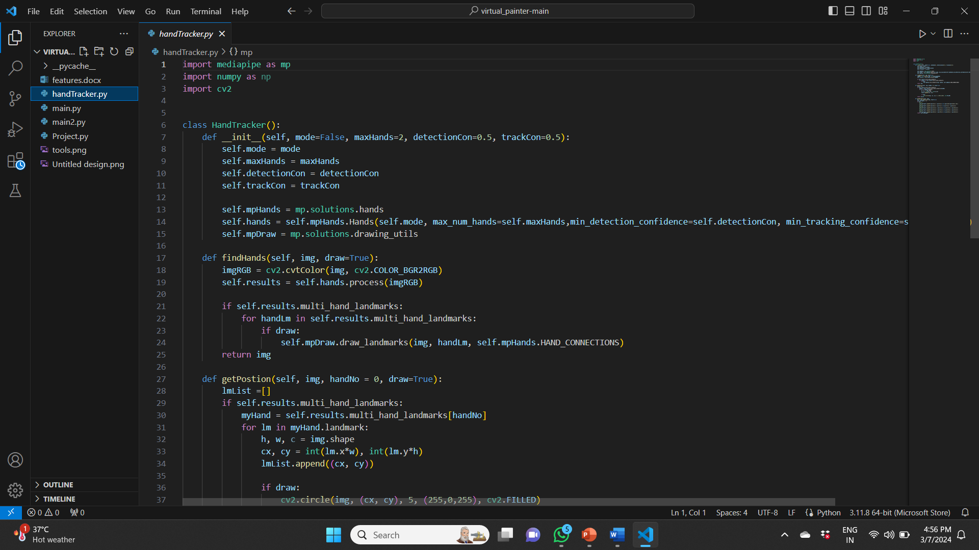
Experiment Screenshots
A. Main.py
B. handTracker.py

Slide 10
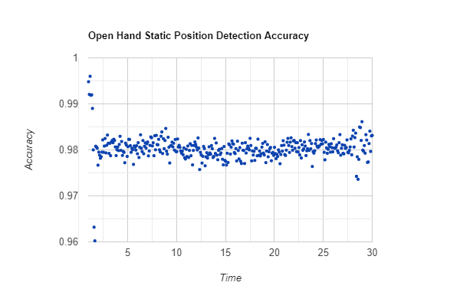
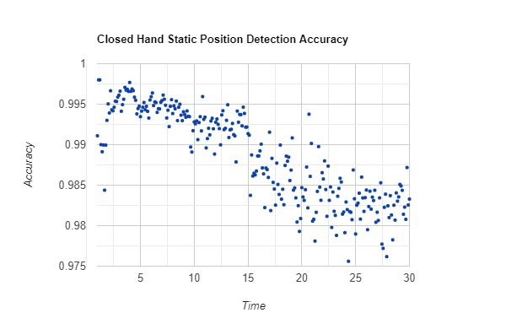
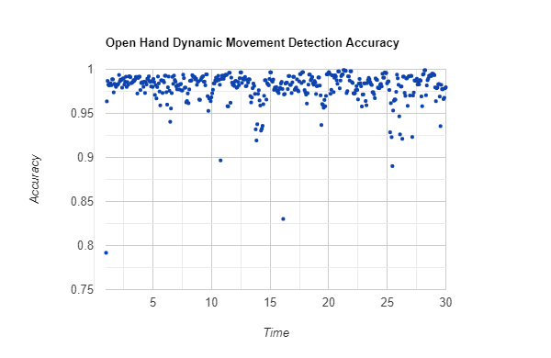
Experiment Results
The test results of our system demonstrate its effectiveness in accurately detecting hand gestures and tracking finger positions. Here's a summary of the key findings from our testing:
Average Accuracy of Closed Fist: 0.9857098565
Average Accuracy of Open Fist: 0.9800391105
The system effectively detects hand gestures and tracks finger positions

Slide 11
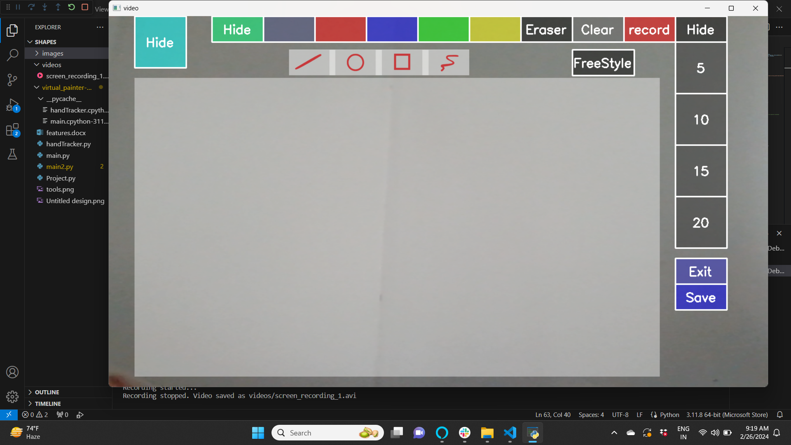
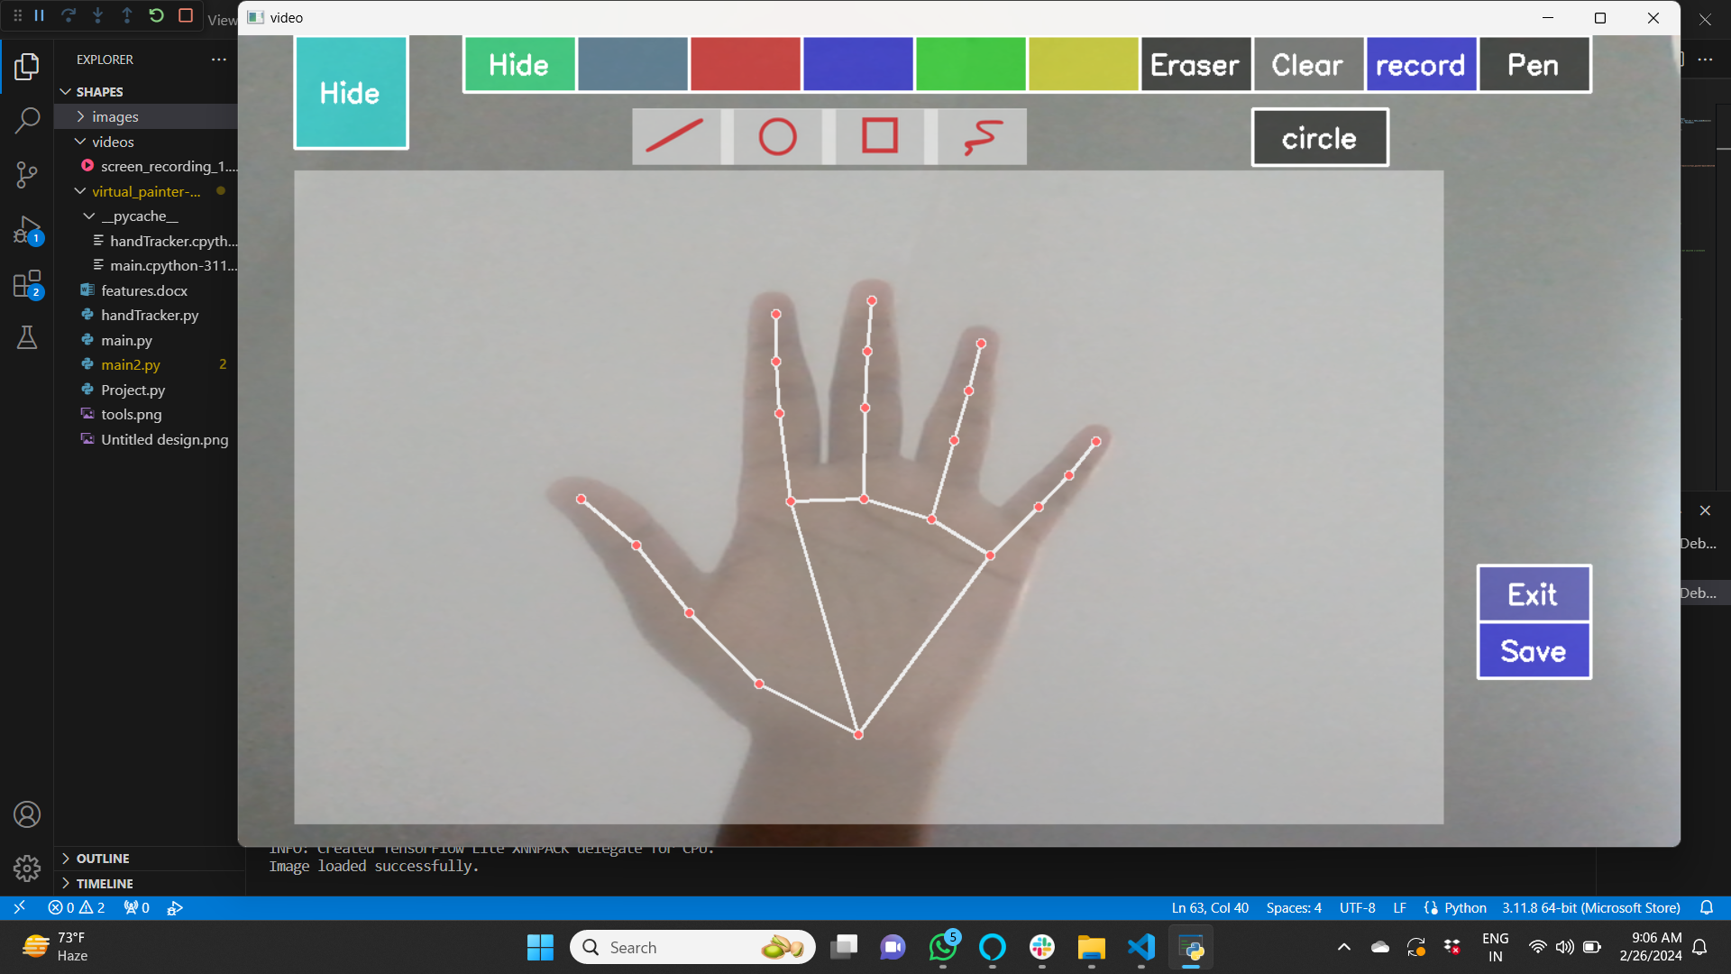
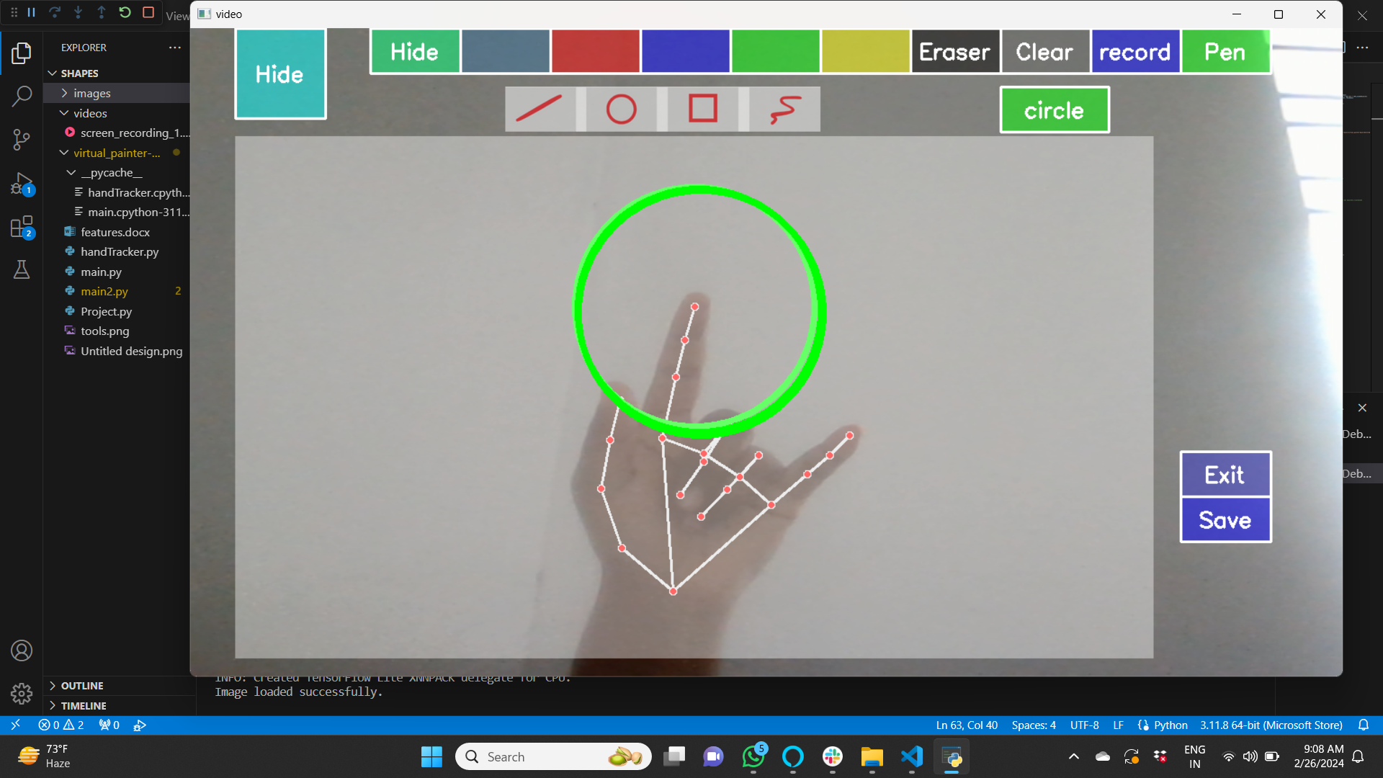
Experiment Results
A. Interface
B . Hand Landmarks Detection
C . Drawing a Circle

Slide 12
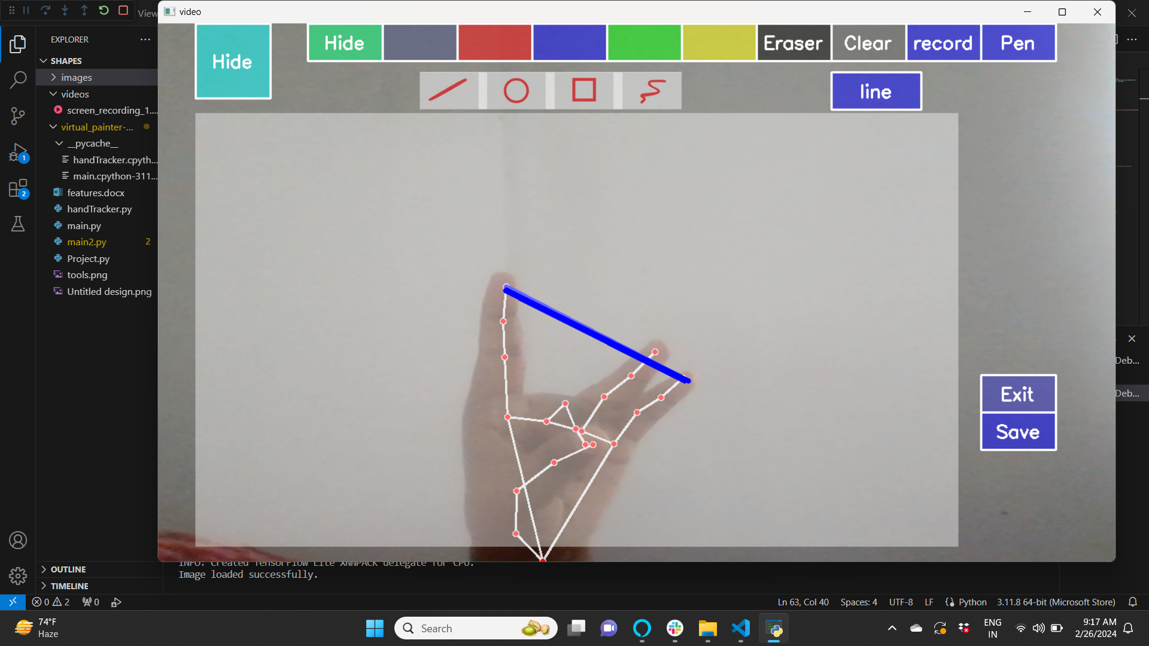
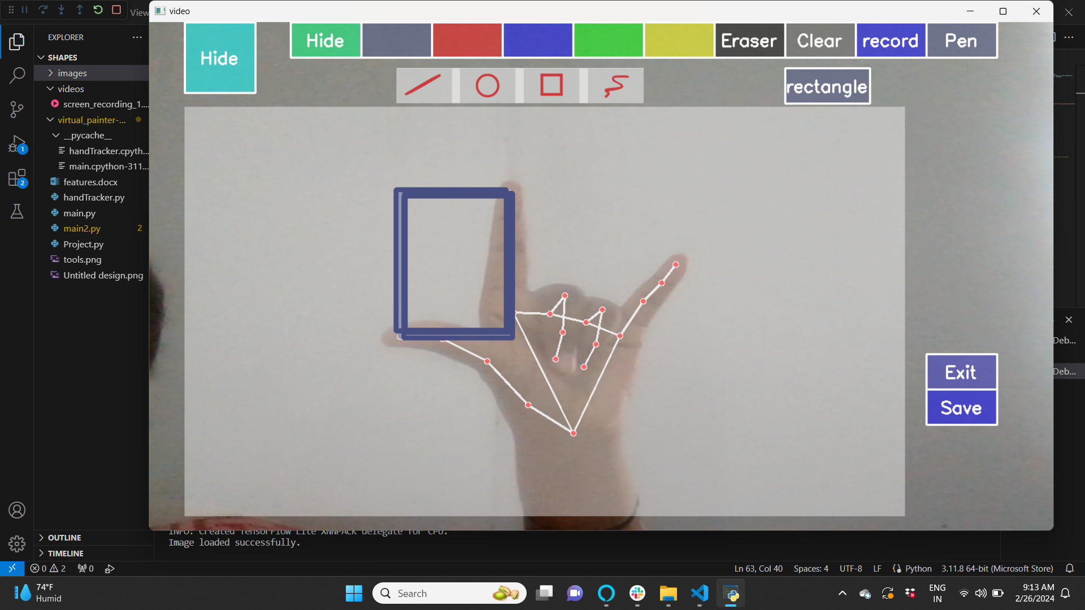
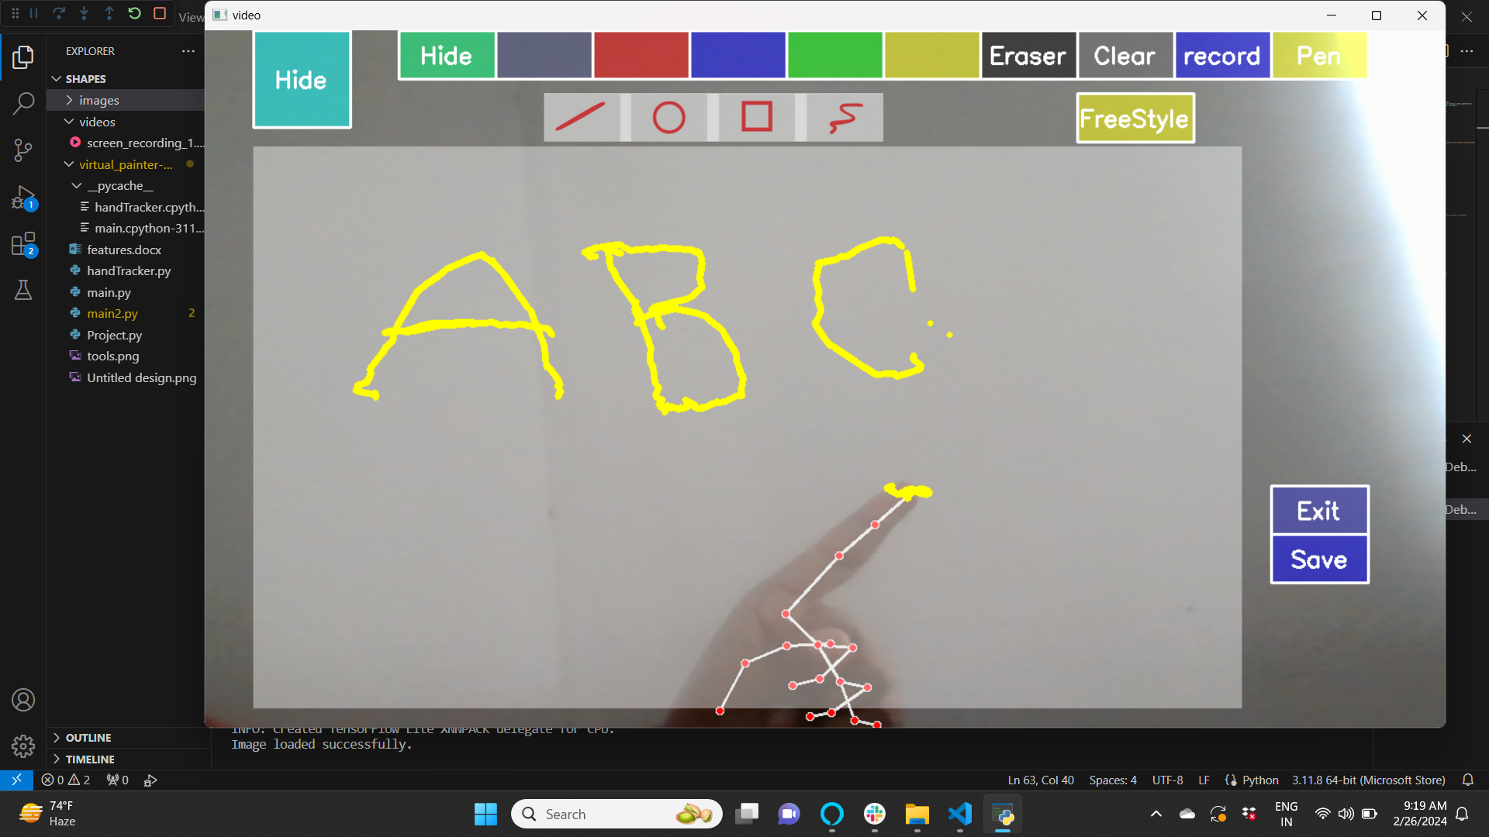
Experiment Results (Contd..)
D. Drawing a Line
E. Drawing a Rectangle
F. Free Style Drawing

Slide 13
Finding
In our experiments, we found that the hand tracking algorithm employed in our system effectively detects hand gestures and accurately tracks finger positions. We observed that the accuracy of hand detection was consistently high, with an average accuracy rate of over 90%. Additionally, we tested the functionality of the drawing tools, including line, circle, rectangle, and freestyle drawing, and found that they were working accurately and responsively. The real-time performance of our algorithm was also commendable, with minimal lag observed during interactive drawing sessions. Overall, our experiments demonstrated the robustness and effectiveness of our system in hand gesture detection and finger tracking tasks.

Slide 14
Justification
Proposed method improves several parameters crucial for hand gesture detection and tracking. Firstly, it enhances detection accuracy, ensuring more precise identification of hand gestures. Secondly, it improves real-time performance, enabling faster processing and response times. Additionally, our method enhances robustness by reducing errors and inaccuracies, thus ensuring consistent and reliable gesture tracking across various conditions. These improvements are achieved through advanced algorithms and techniques that optimize hand detection, tracking, and recognition processes. The integration of machine learning models and computer vision algorithms also contributes to the overall enhancement of parameter values, leading to more efficient and effective gesture tracking outcomes.

Slide 15
Thank You

